Slide 1
Presentation Created for
South Carolina Department of Alcohol & Other Drug Abuse Services

Slide 2
HOUSEKEEPING
This presentation is intended for educational purposes only for educators, schools, and parents (not intended for youth).
This is a drug awareness presentation. If you need more help/resources, please contact your local prevention/education agencies.
Everything is person-specific. "No one thing means any one thing."
Images are purchased stock images.
Created July 2020

Slide 3
Topics Highlighted in This Presentation
A quick look at vaping trends
Youth vaping trends and dangers
State-specific information
Resources for parents and professionals

Slide 4
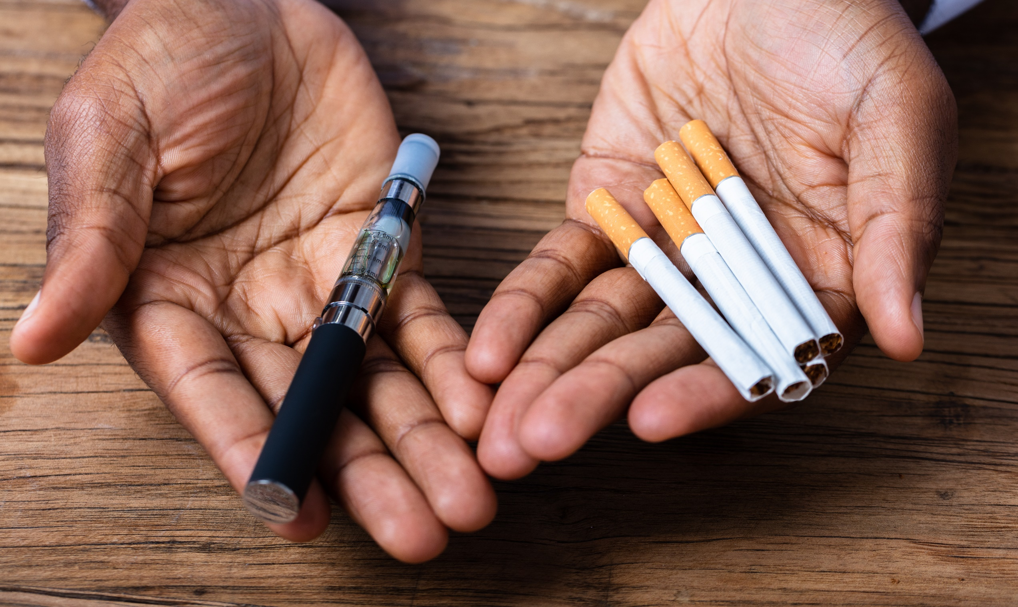
VAPING

Slide 5
What Is a Vape Pen ?
Vapes, vaporizers, vape pens, hookah pens, electronic cigarettes (e-cigarettes or e-cigs), and e-pipes are some of the many terms used to describe electronic nicotine delivery systems (ENDS).
ENDS are noncombustible tobacco products.
These products use an "e-liquid" that may contain nicotine, as well as varying compositions of flavorings, propylene glycol, vegetable glycerin, and other ingredients. The liquid is heated to create an aerosol that the user inhales.
Source: fda.Gov

Slide 6
Vapor Aerosol Questions
What many of us call a "vapor" the CDC and other professionals reference as an aerosol. This is what is inhaled by the user when they take a draw on the vape similar to how they would take a draw from a regular tobacco cigarette.
In other words, the "vapor" is actually an "aerosol."

Slide 7
What Is E-cigarette Aerosol?
The e-cigarette aerosol that users breathe from the device and exhale can contain harmful and potentially harmful substances, including:
Nicotine
Ultrafine particles that can be inhaled deep into the lungs
Flavoring such as diacetyl, a chemical linked to a serious lung disease
Volatile organic compounds
Cancer-causing chemicals
Heavy metals such as nickel, tin, and lead
It is difficult for consumers to know what e-cigarette products contain. For example, some e-cigarettes marketed as containing 0% nicotine have been found to contain nicotine.
Source: cdc.gov

Slide 8
Are E-Cigarettes Regulated Federally?
Yes. In August 2016, the regulatory authority of the FDA was extended to cover e-cigarettes through the agency's "deeming rule."
Through authority granted by the Family Smoking Prevention and Tobacco Control Act (FSPTCA), the FDA has the authority to develop regulations that address the manufacturing, marketing, and sale of e-cigarettes.
There are some strategies that the FDA does not have authority to implement, such as including e-cigarettes in smoke-free policies or increasing the minimum legal sales age for these products, unless directed to do so by Congress.
Source: cdc.gov

Slide 9
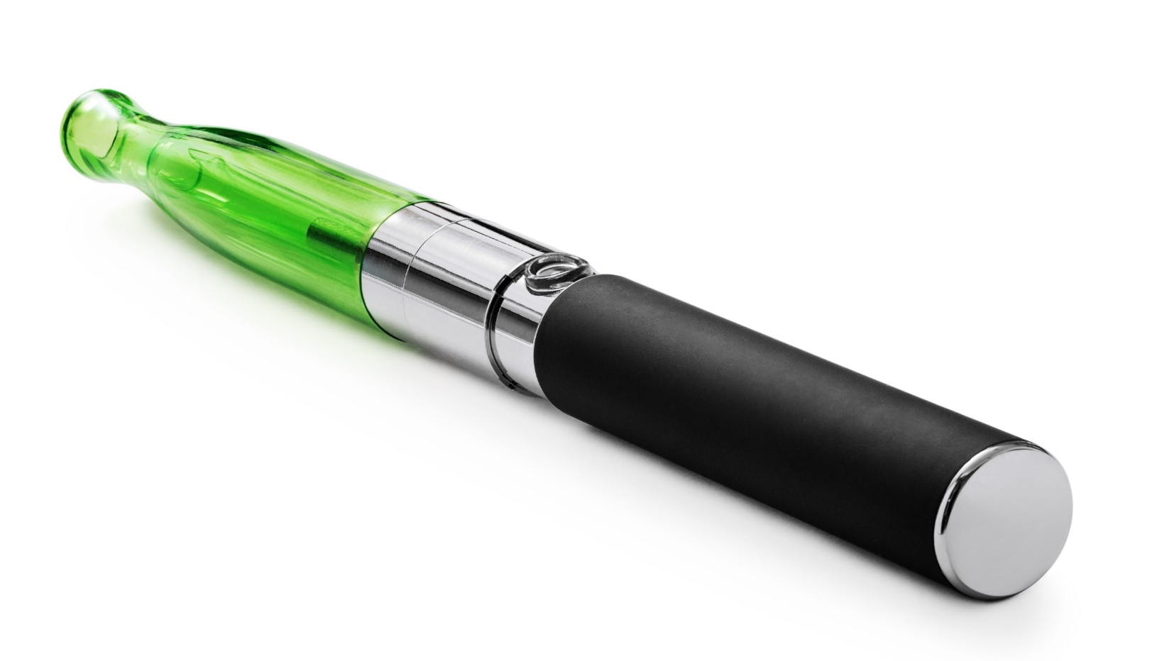
Vape Pen (AKA E-Cigarette)

Slide 10
"Street-Level" Terms for Vape Pens
E-cigarette (E-cig) or Electronic Cigarette – the device we know as a "vape pen"
Dab Pen - a device used for the consumption of marijuana concentrates. Dab pens can look like standard nicotine vape pens.
MOD(s) – a larger, bulkier, (modified) device that can include certain features or customizations
Keep in mind that vape terminology is person-specific and can vary by individual and region.

Slide 11
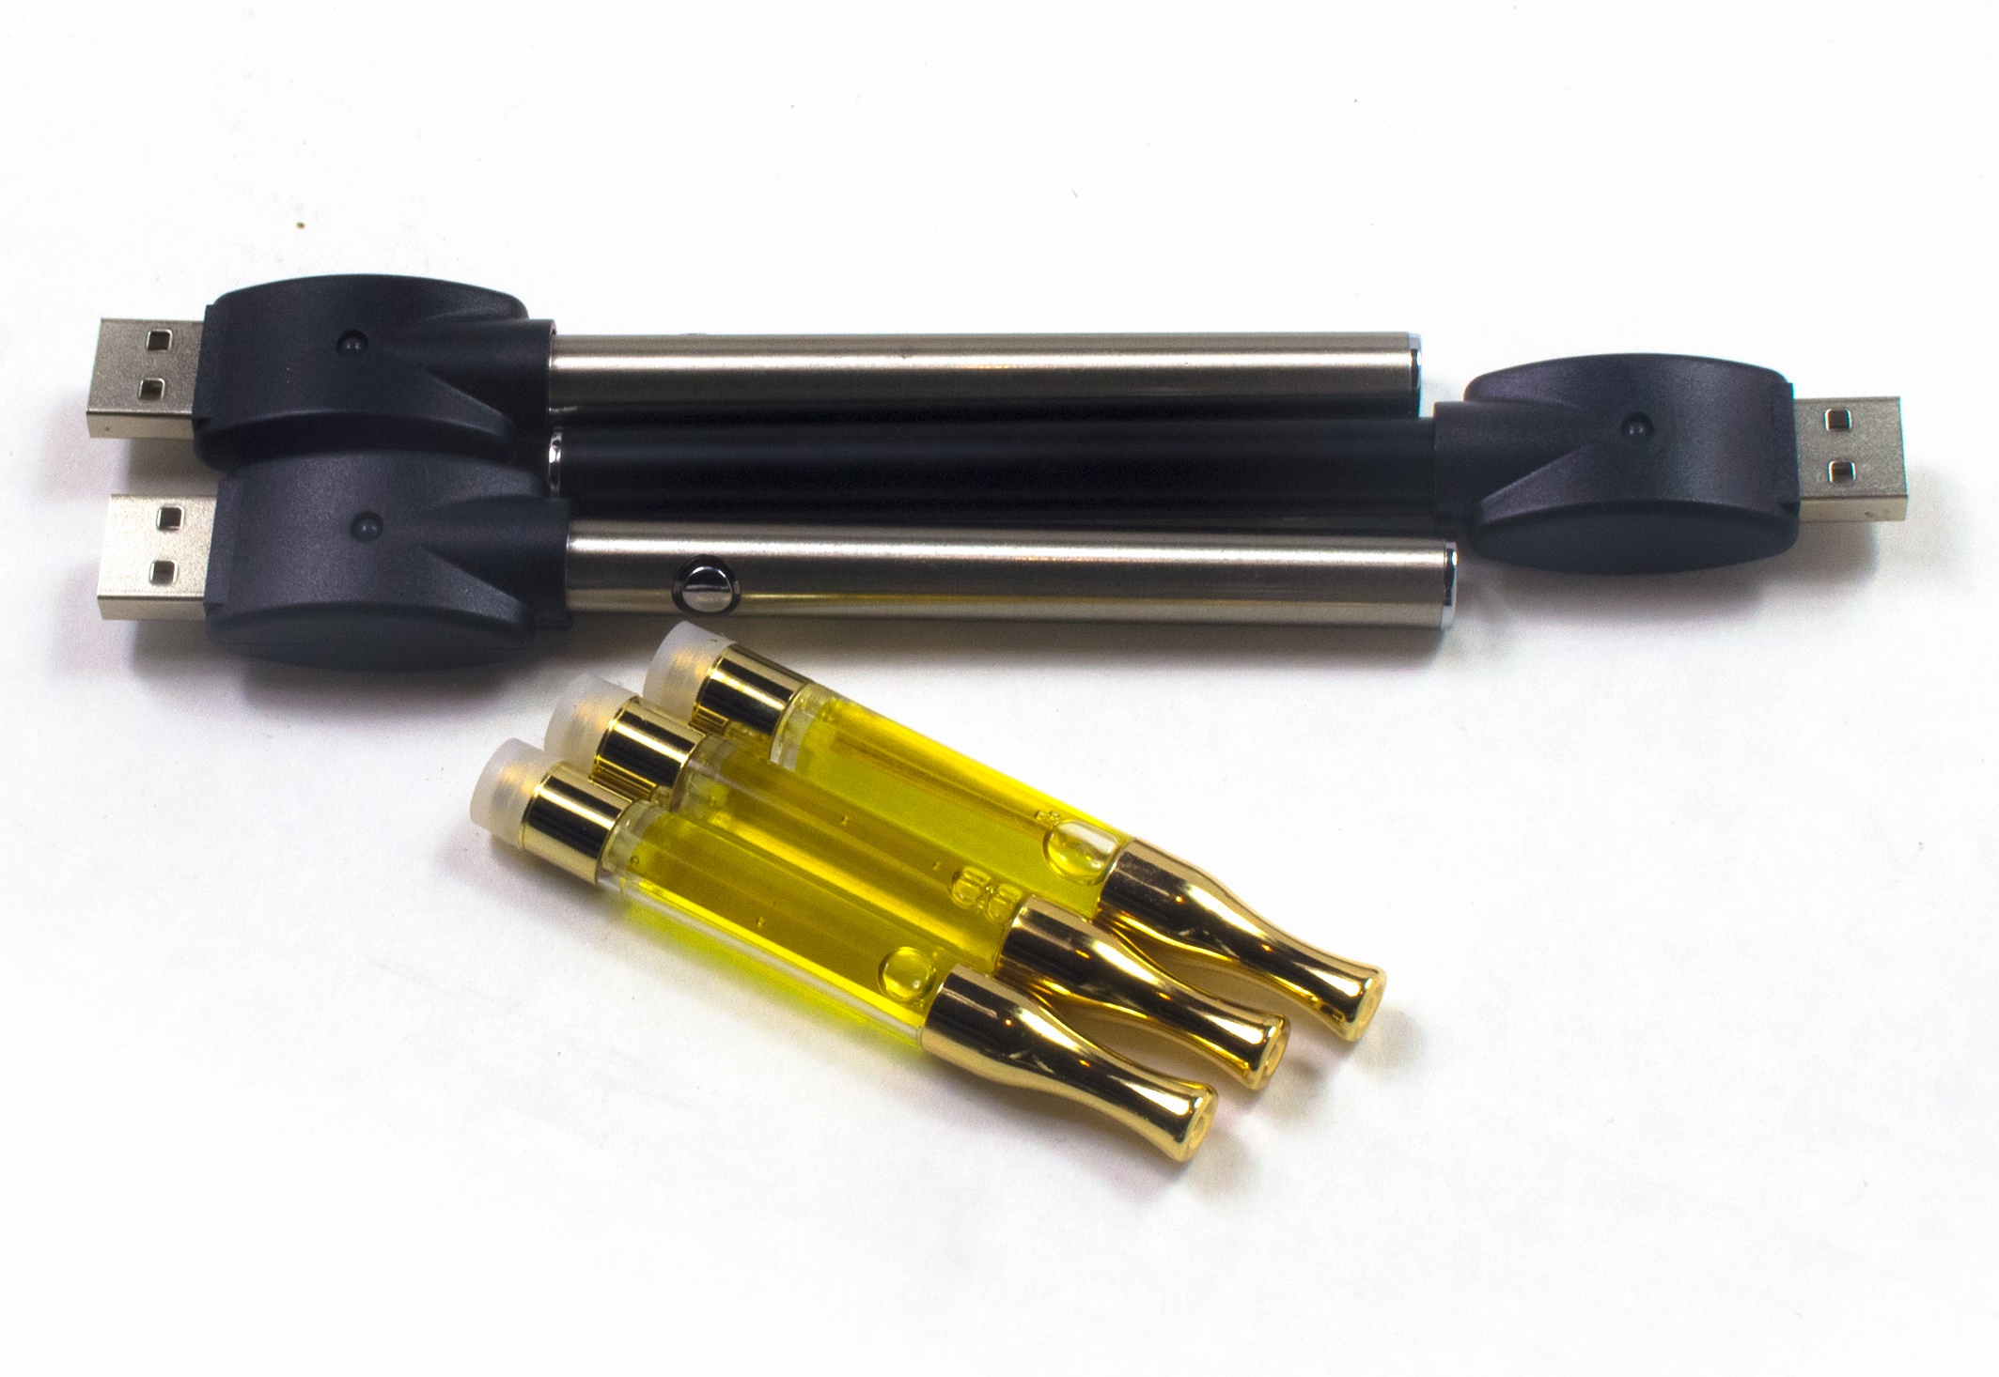
Vape Cartridges, Batteries & USB
Vape
Batteries
USB
Vape
Cartridges
Common Vape Pen Components

Slide 12
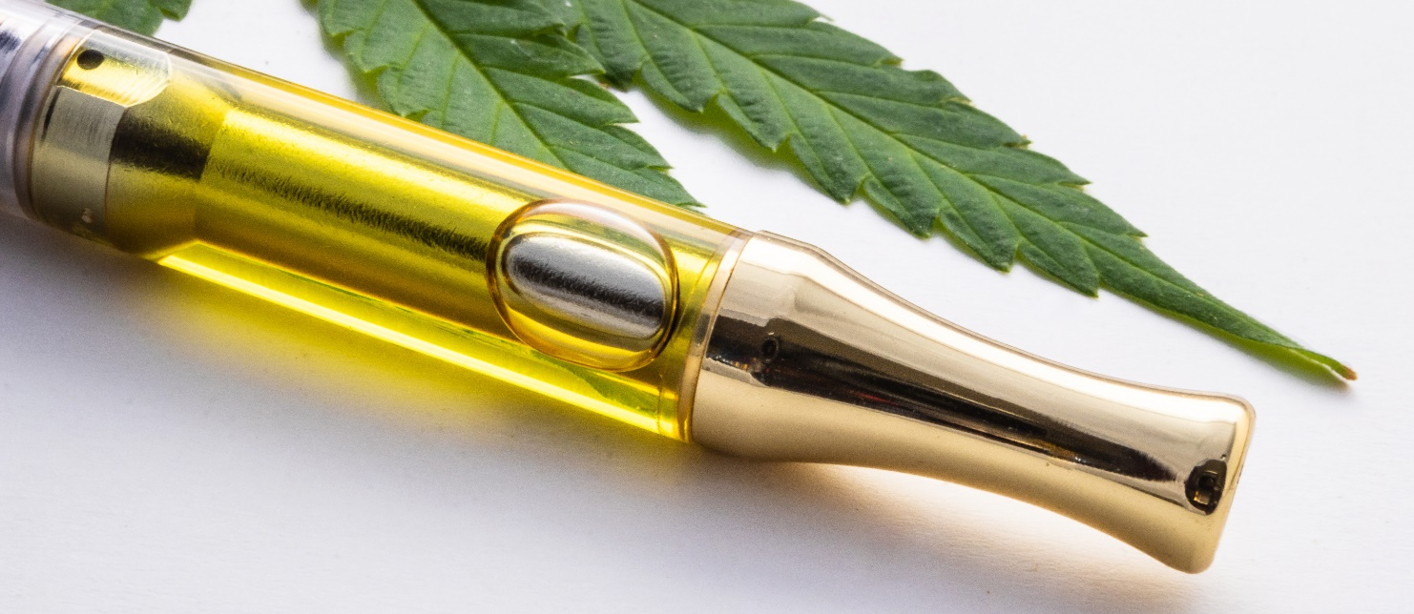
What Is a Vape Cartridge?
A pre-filled or empty bowl that is located just under the mouthpiece.
Some of the cartridges can be preloaded with nicotine, THC, or other products.
It can be hard to determine what is actually inside of the cartridge.
The cartridge then threads onto the battery of the vape.

Slide 13
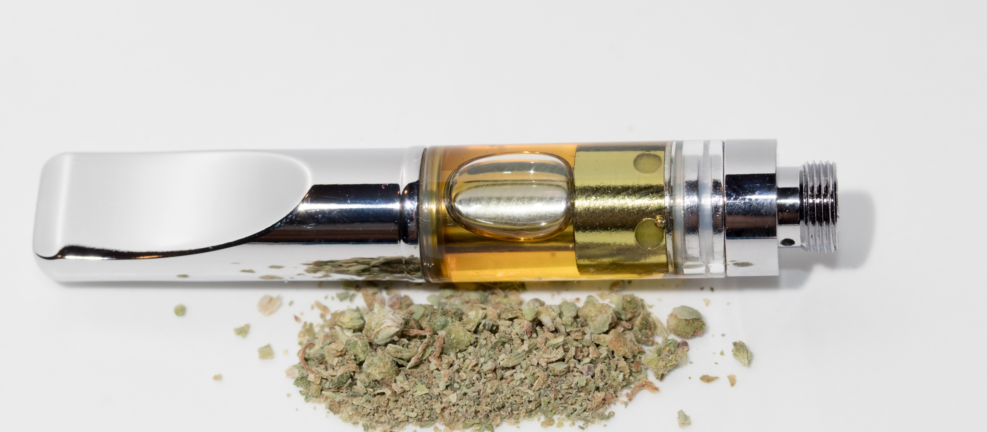
Vape Pen Cartridge

Slide 14
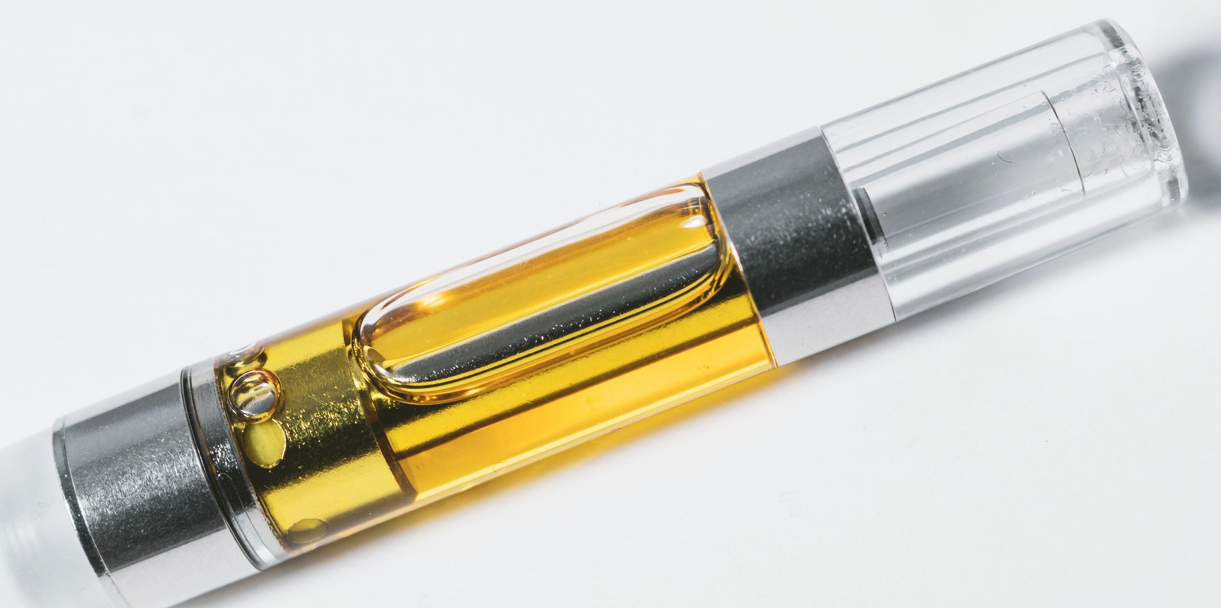
Vape Pen Cartridge

Slide 15
Harms to Teens
The use of e-cigarettes is unsafe for kids, teens, and young adults.
Most e-cigarettes contain nicotine. Nicotine is highly addictive and can harm adolescent brain development, which continues into the early- to mid-20s.
E-cigarettes can contain other harmful substances besides nicotine.
Young people who use e-cigarettes may be more likely to smoke cigarettes in the future.
More info: https://www.cdc.gov/tobacco/basic_information/e-cigarettes/Quick-Facts-on-the-Risks-of-E-cigarettes-for-Kids-Teens-and-Young-Adults.html
Source: cdc.gov

Slide 16
More Harms To Youth
Most e-cigarettes contain nicotine, the highly addictive drug in tobacco. Nicotine is especially harmful to young people. The human brain keeps developing until around the age of 25. Using products with nicotine under age 25 can harm the part of the brain responsible for memory, attention, and learning.
More Info: https://www.cdc.gov/tobacco/features/back-to-school/e-cigarettes-talk-to-youth-about-risks/index.html
Source: cdc.gov

Slide 17
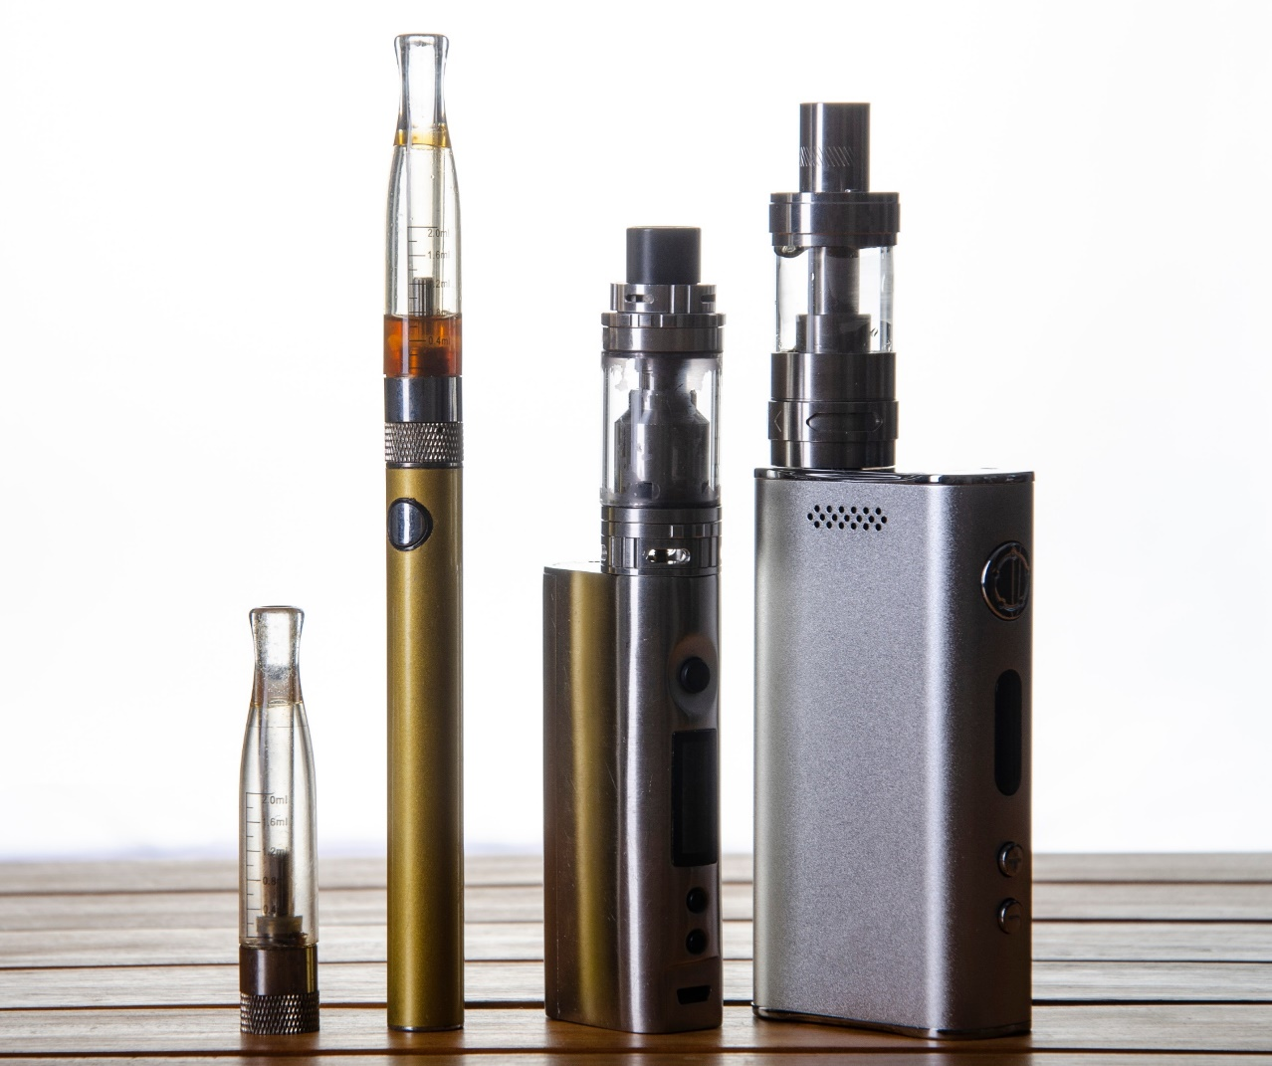
Vape Pens / E-Cigs at a Glance
VAPE
CARTRIDGE
MOUTHPIECE
VAPE BATTERY
MOD
VAPE DEVICE
MOD
VAPE DEVICE

Slide 18
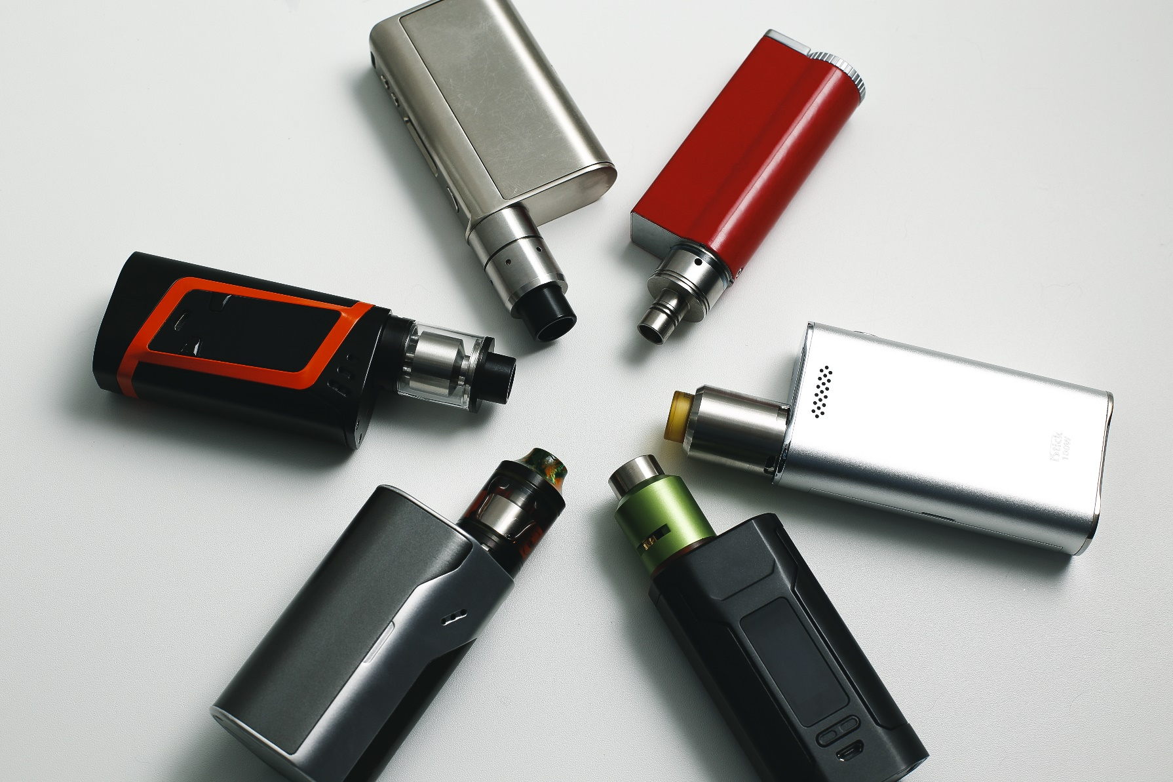
Vapes "Mods"
Vape mods are generally larger than a standard or traditional e-cigarette. The term "mod" is short for modified device or a device that can be modified by the user in various ways.

Slide 19
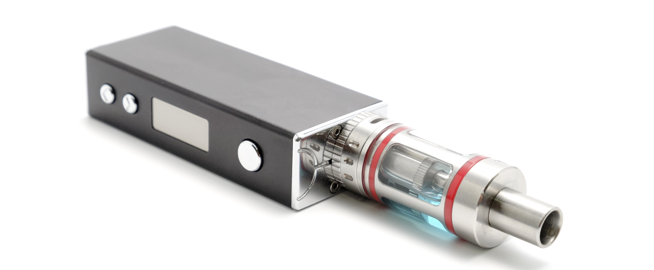
Vape Mod With Mouthpiece

Slide 20
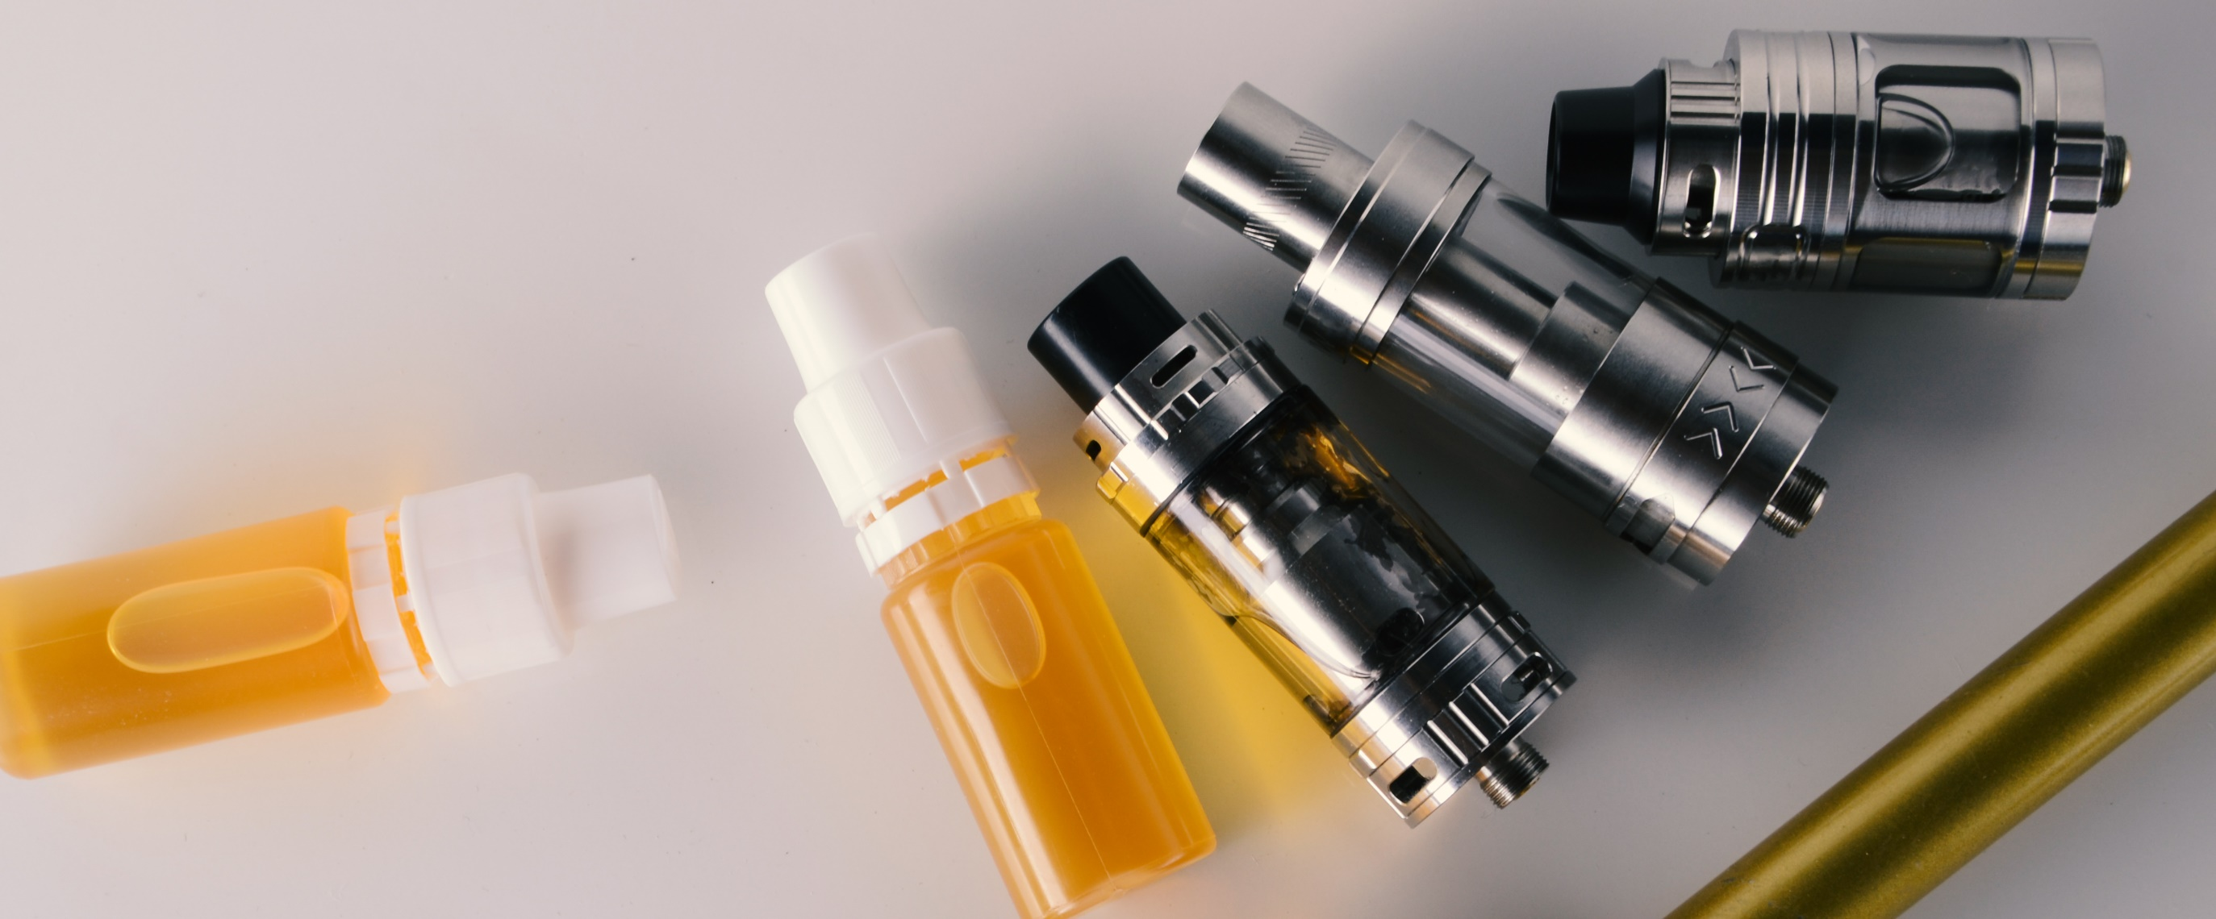
Vape Mod Mouthpiece

Slide 21
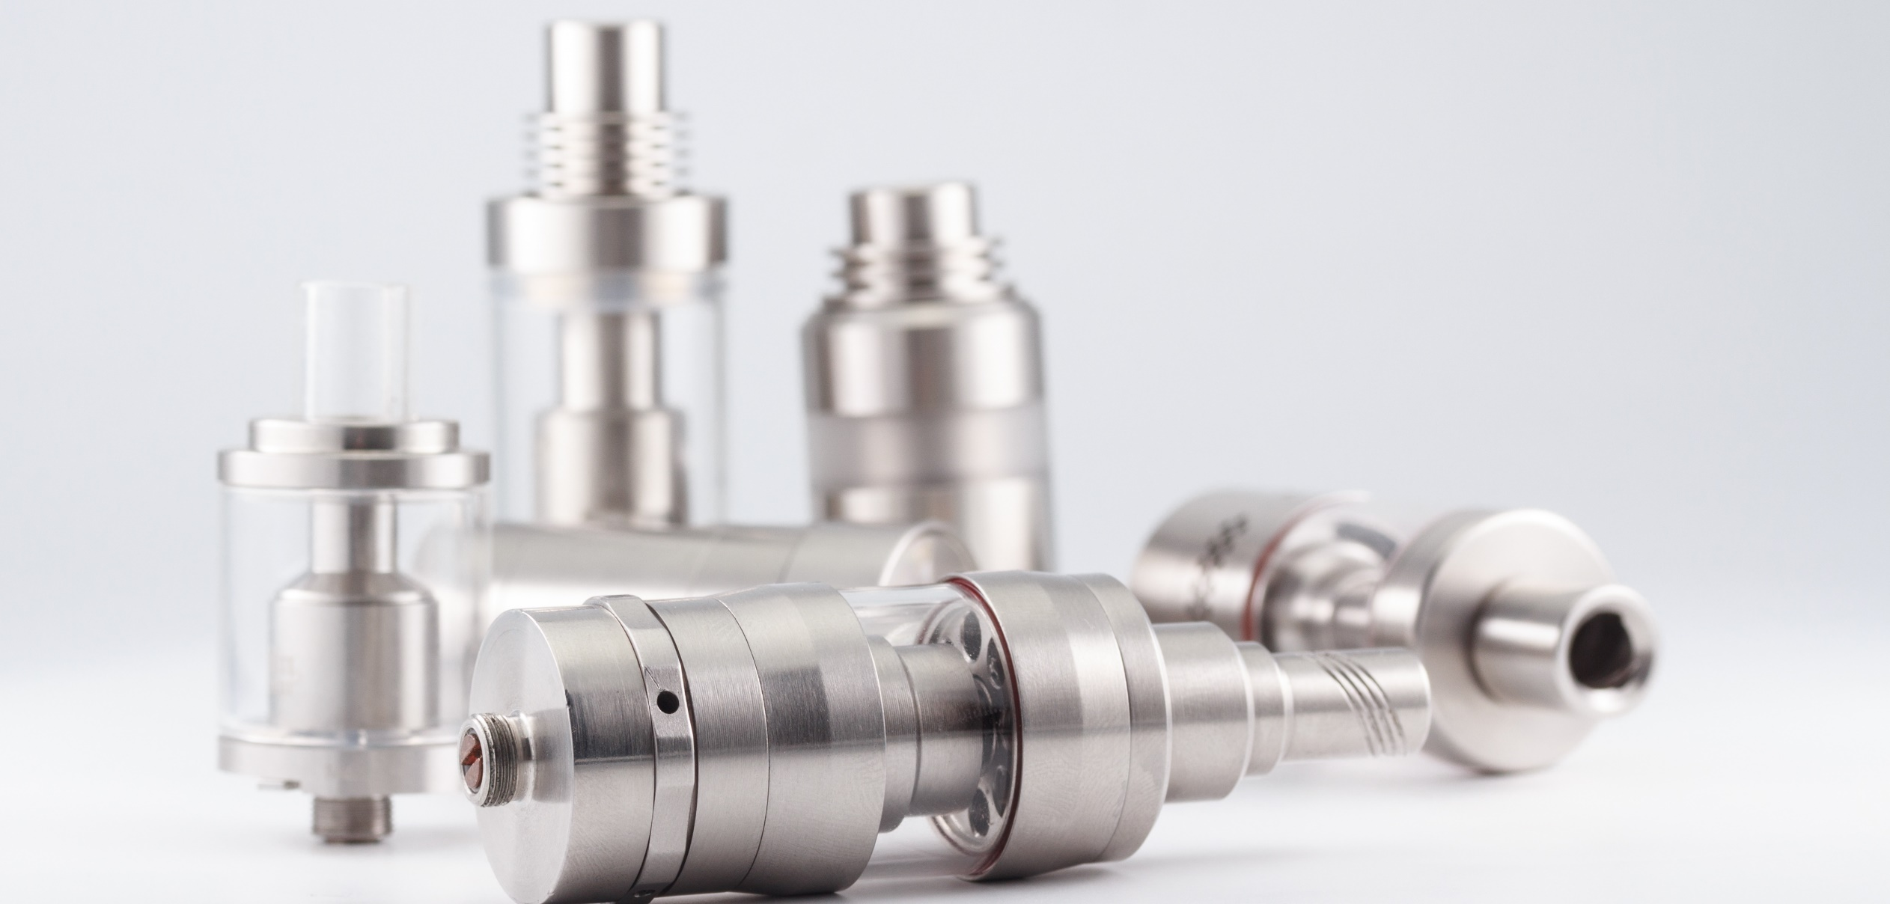
Vape Mod Mouthpiece

Slide 22
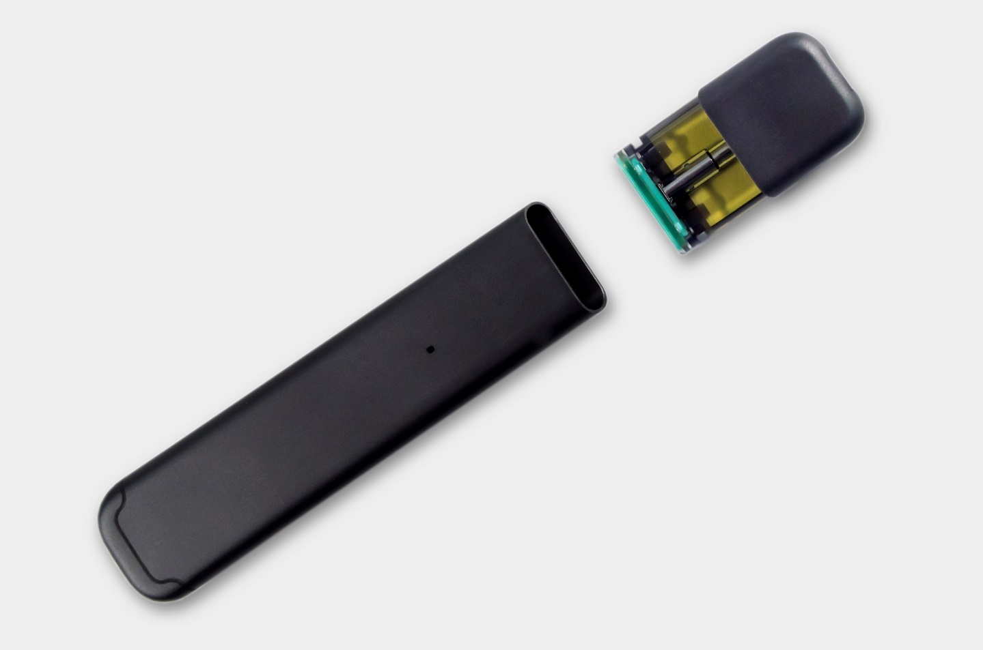
Vapes & Vape Pod Systems

Slide 23
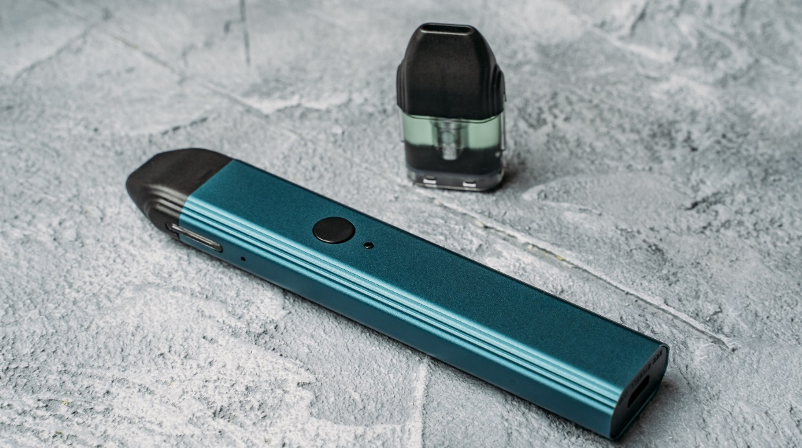
Devices With Pods
A two-part vape pen that includes a battery and a removable pod
The pod is either prefilled (generally disposable) or refillable (generally reusable).
Also known as vape pods or pod mods

Slide 24
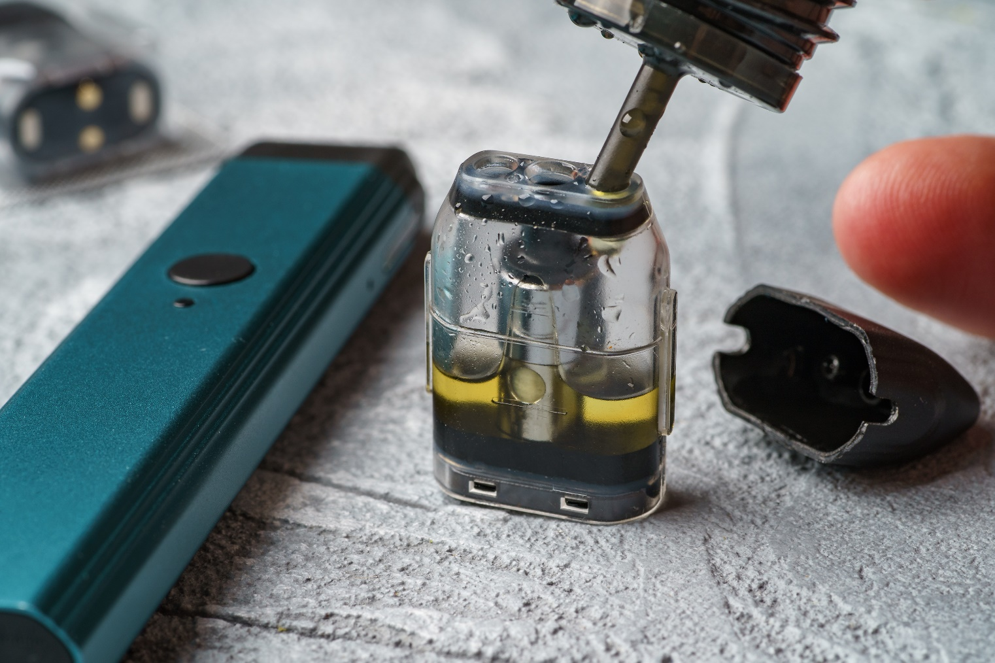
Self-Loading Vape Pods

Slide 25
Preloaded Vape Devices
These are preloaded disposable vape pens.
They have an approximate number of puffs, after which you throw the entire device away.
No on/off switch – you just take a draw.
Mouthpiece is attached to device.
AKA "vape stick" or "nic stick"

Slide 26
Marijuana Vapes
Marijuana vapes can be hard to distinguish from some nicotine vapes.
Many can work for:
Dry leaf marijuana
Dabs or concentrated forms of marijuana
Marijuana oils

Slide 27
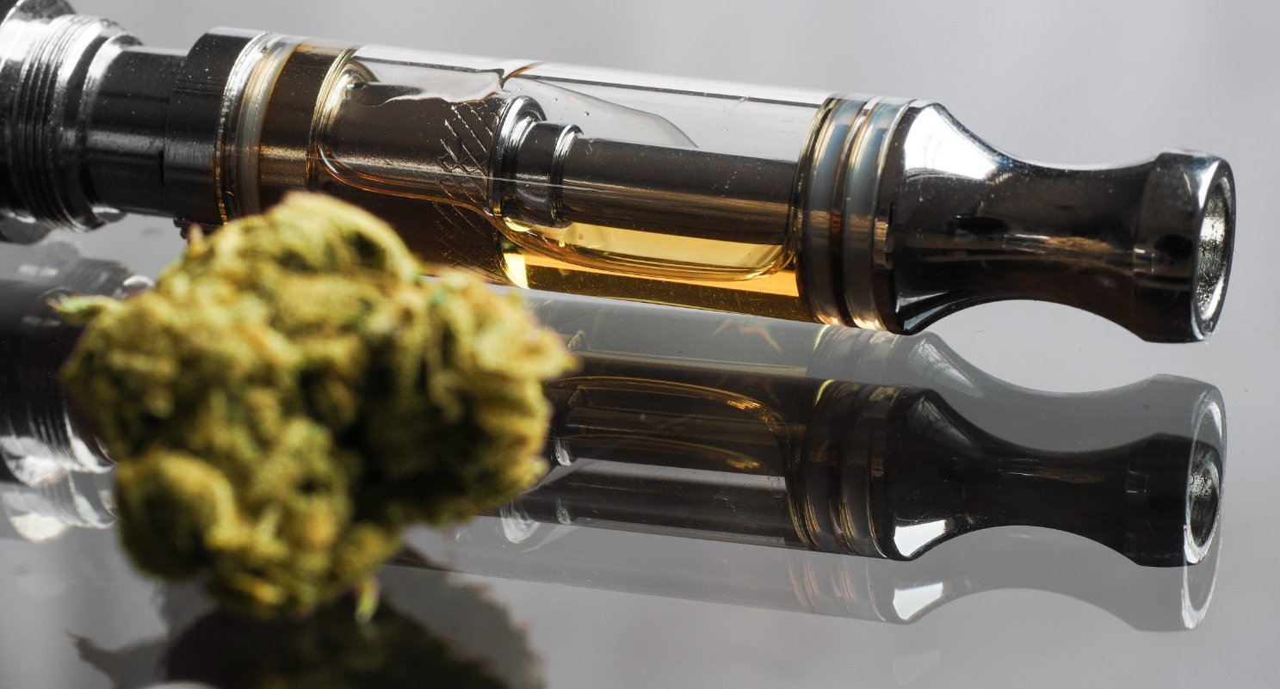
Various cannabis vapes can use a leaf form while others can use an oil form.

Slide 28
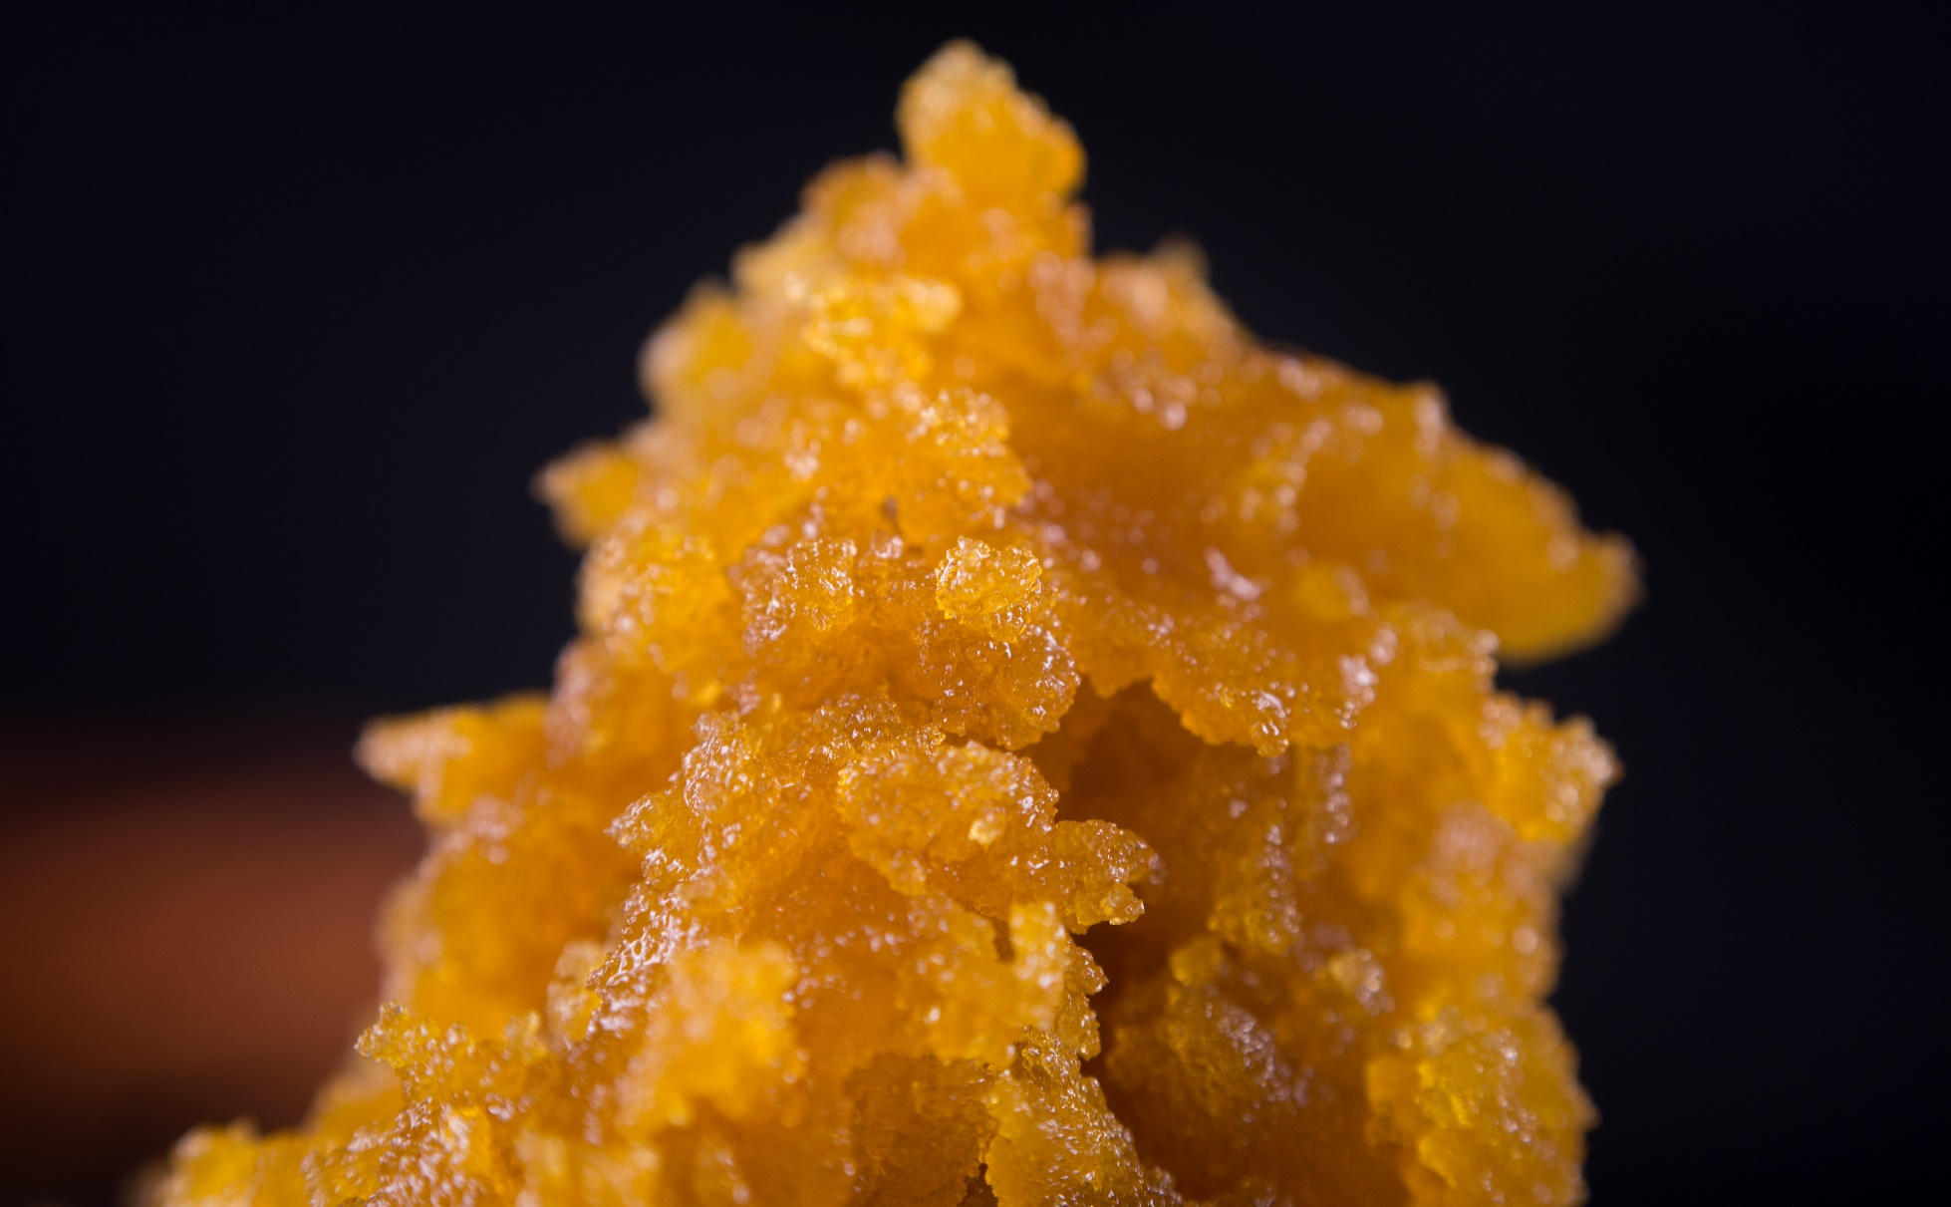
Dab Pen
A vape pen used to smoke a concentrated "dab" form of cannabis
Many will use a dab tool to load the dab into the vape pen.

Slide 29
Dab Pen Information
Dab pens can be purchased:
Online
Through some phone apps
At some convenience/neighborhood stores
From smoke shops (head shops)
From marijuana dispensaries
At some vape shops

Slide 30
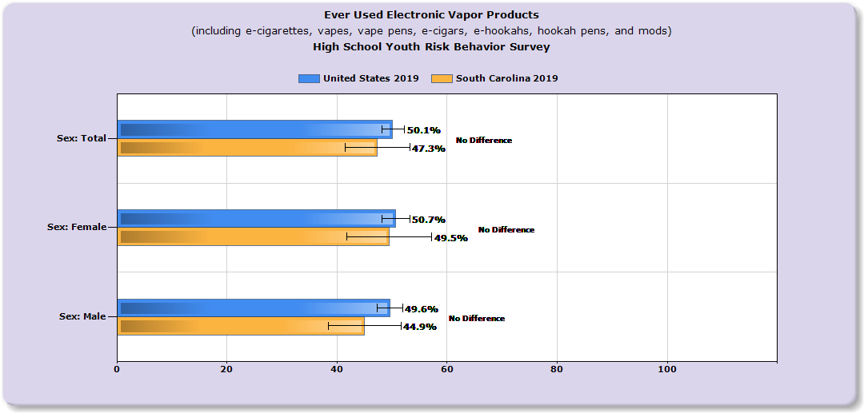
South Carolina Data
Source: https://nccd.cdc.gov/youthonline/App/Results

Slide 31
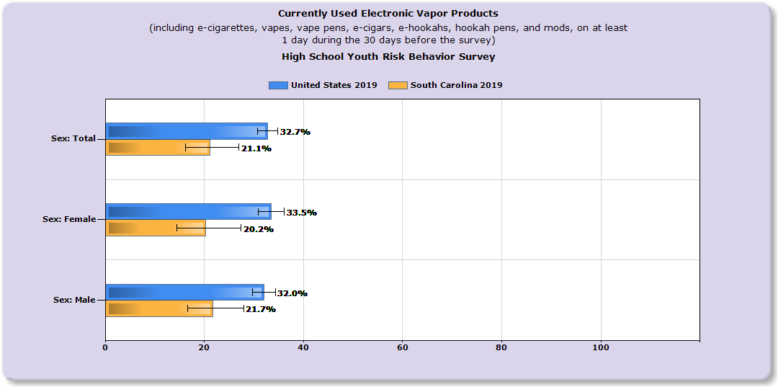
South Carolina Data
Source: https://nccd.cdc.gov/youthonline/App/Results

Slide 32
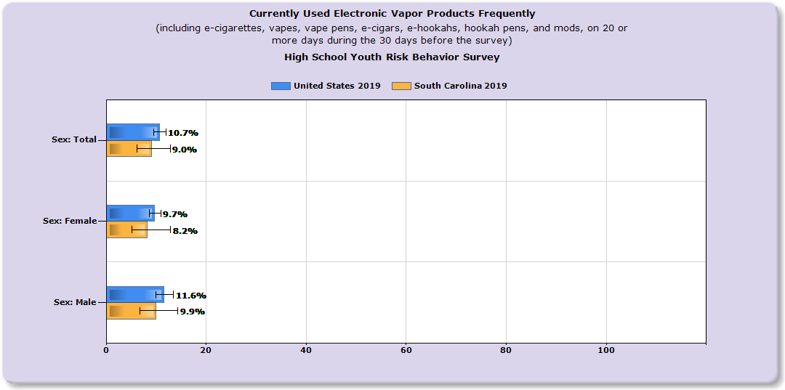
South Carolina Data
Source: https://nccd.cdc.gov/youthonline/App/Results

Slide 33
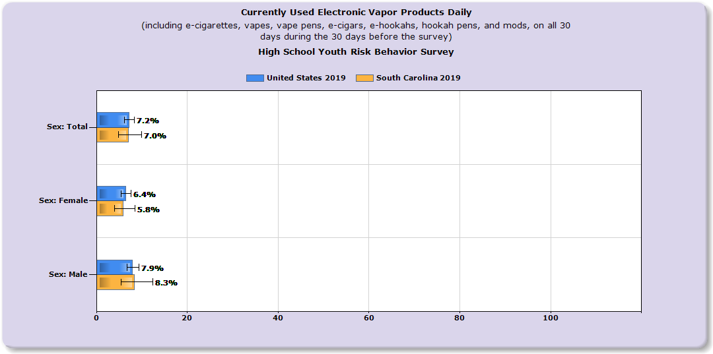
South Carolina Data
Source: https://nccd.cdc.gov/youthonline/App/Results

Slide 34
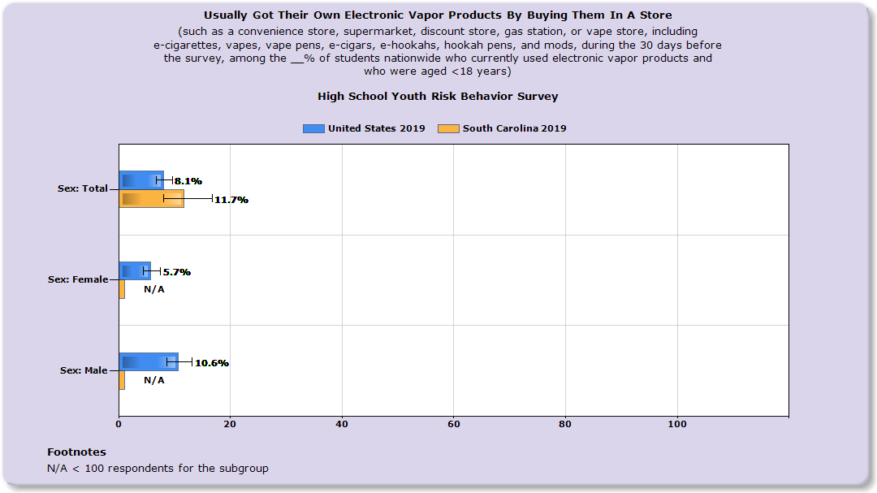
South Carolina Data
Source: https://nccd.cdc.gov/youthonline/App/Results

Slide 35
IN CLOSING
Talk to your kids! Have several drug "conversations."
Education and prevention start early.
Drug abuse prevention requires a multifaceted approach.
Seek help from a professional early if needed!

Slide 36
Resources for Parents & Professionals
CDC Quick Vape Facts - https://www.cdc.gov/tobacco/basic_information/e-cigarettes/Quick-Facts-on-the-Risks-of-E-cigarettes-for-Kids-Teens-and-Young-Adults.html
CDC Teen Vape Sheets - https://www.cdc.gov/tobacco/basic_information/e-cigarettes/Quick-Facts-on-the-Risks-of-E-cigarettes-for-Kids-Teens-and-Young-Adults.html
CDC Ecig/Product - Dictionary-images-https://www.cdc.gov/tobacco/basic_information/e-cigarettes/pdfs/ecigarette-or-vaping-products-visual-dictionary-508.pdf
Surgeon General - Vapes-https://e-cigarettes.surgeongeneral.gov/knowtherisks.html
CDC Smoking & Youth - https://www.cdc.gov/tobacco/data_statistics/sgr/50th-anniversary/pdfs/fs_smoking_youth_508.pdf
CDC What Are E Cigs? - https://www.cdc.gov/tobacco/basic_information/e-cigarettes/about-e-cigarettes.html
Vape Facts by Johns Hopkins Medicine - https://www.hopkinsmedicine.org/health/wellness-and-prevention/5-truths-you-need-to-know-about-vaping
TALL COP SAYS STOP Website: www.tallcopsaysstop.com

Slide 37
YOUR CONTACT INFO HERE
Contact Info

